Slide 1

Data Analysis on Cricket dataset Big Data-CSCI 527
Sandeep Ramakrishnan
Mentored By: Milton King

Slide 2
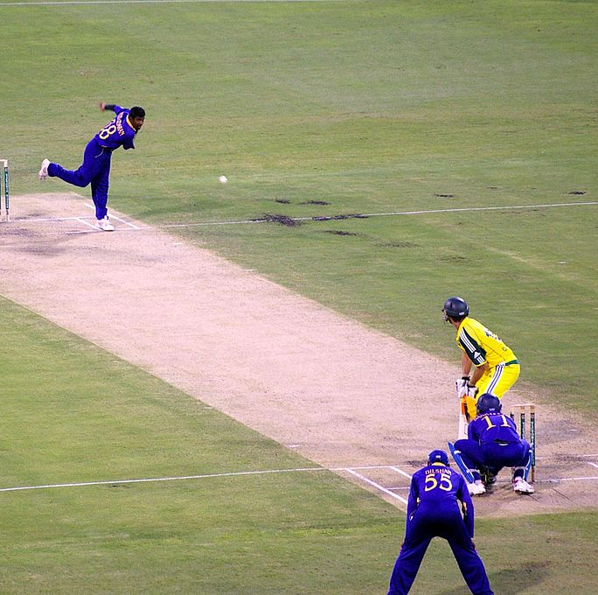
Introduction
Cricket is a bat-and-ball game played between two teams of eleven players on a field at the center of which is a 22-yard pitch.
Cricket is a sport where it is difficult to anticipate the performance of a player.
Our model can predict the performance of a cricketer in terms of his batting performance which is an efficient as it help recruiters in a selection process.
This Photo by Unknown author is licensed under CC BY-SA.
Notes:
With a batting pitch in the centre , with a wicket at each end. The wicket is bail with three stumps. The batting side scores runs by striking the ball bowled
The batting team is considered out when the ball is caught or stumped by the bowling team ,if all the ten player are out , the bowling team will bat to chase the run scored by batting team
Predict the performance of aplayer

Slide 3

Dataset
The dataset has the batting statistics of different player from the world.
The dataset has 2500 rows of unique values.
The dataset has information of retired player and also Active player.
Notes:
We got dataset from cricket data Repository

Slide 4
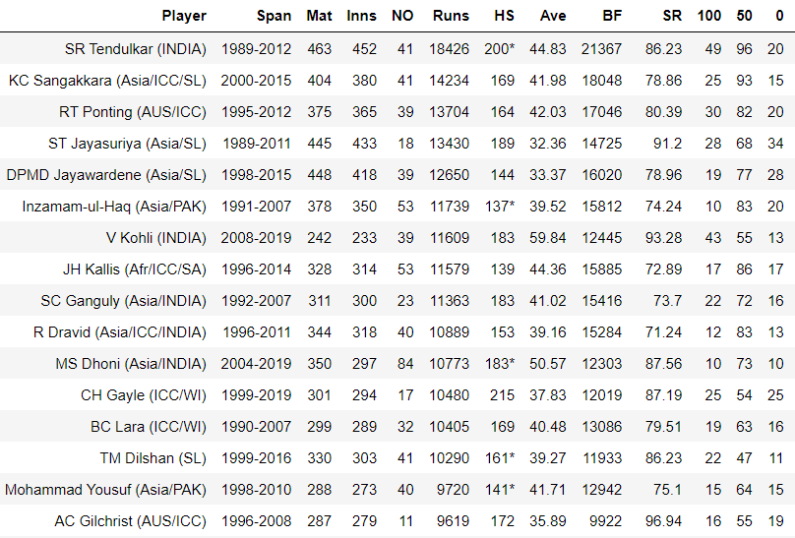
Dataset
Notes:
An innings is one of the divisions of a cricket match during which one team takes its turn to bat. Innings also means the period in which an individual player bats (acts as either striker or nonstriker )
Span –the year the started and the year the collected the data

Slide 5
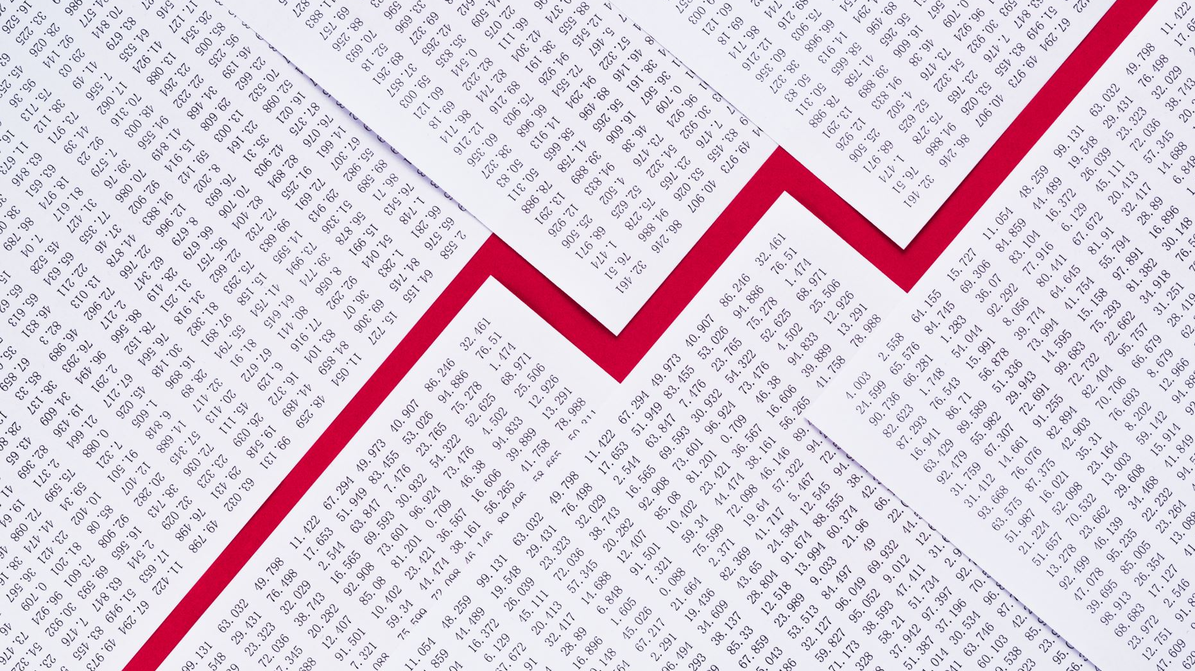
Interesting Findings
The numbers of hundred as a positive correlation to the total runs scored.
The number of matches played has negative correlation with innings played
The dataset can be viewed as regression task
The dataset had very little presence of outliers.
Notes:
The dataset can be viewed as regression task
The classes are ordered and not balanced
We cleaned the outliers with various preprocessing techniques

Slide 6
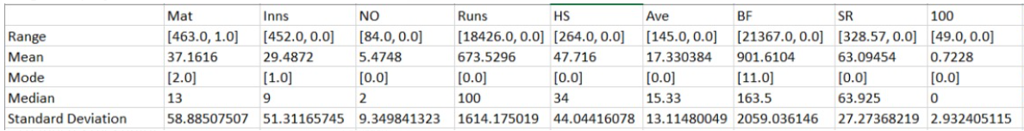
Interesting Findings
On calculating the mean, median and mode values for the attributes in the dataset, following findings are discovered:

Slide 7
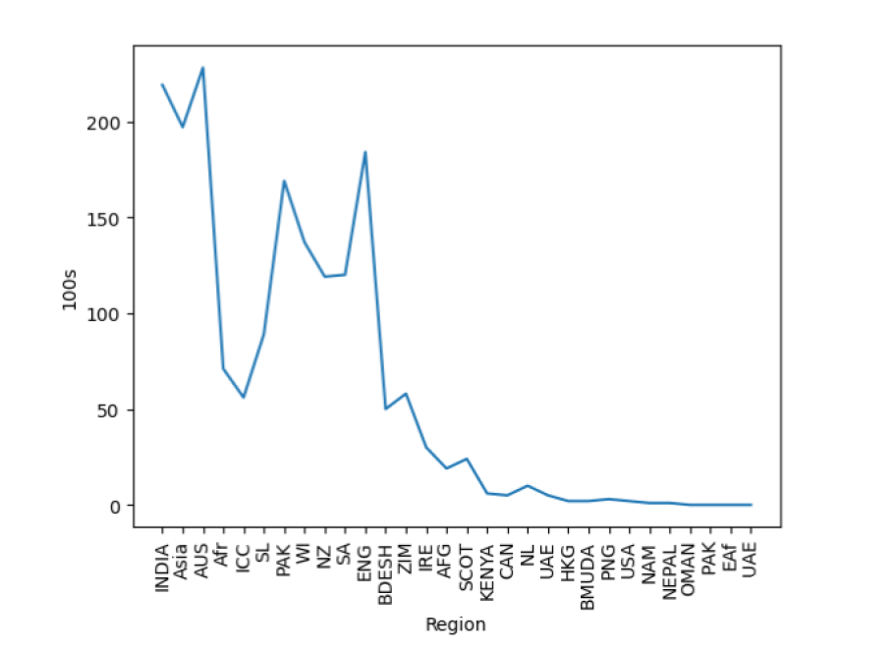
Visualization 1
The given line chart below represents the visualization between no of hundreds (100s) scored by a player to a Region(Country). The chart shows the maximum number of 100s has been scored by the teams.

Slide 8
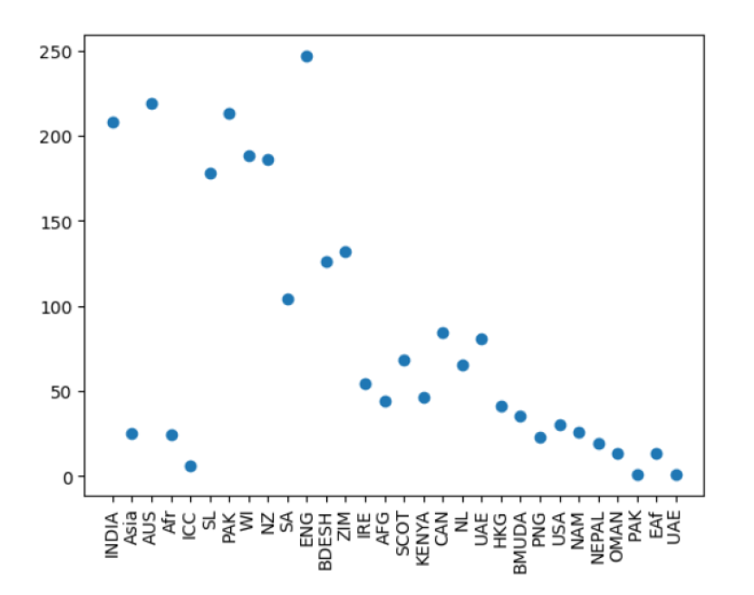
Visualization 2
In the following Scatter Plot, the visualization is between region being the country and player's count. This visualization helps to find the maximum number of players a team has.

Slide 9
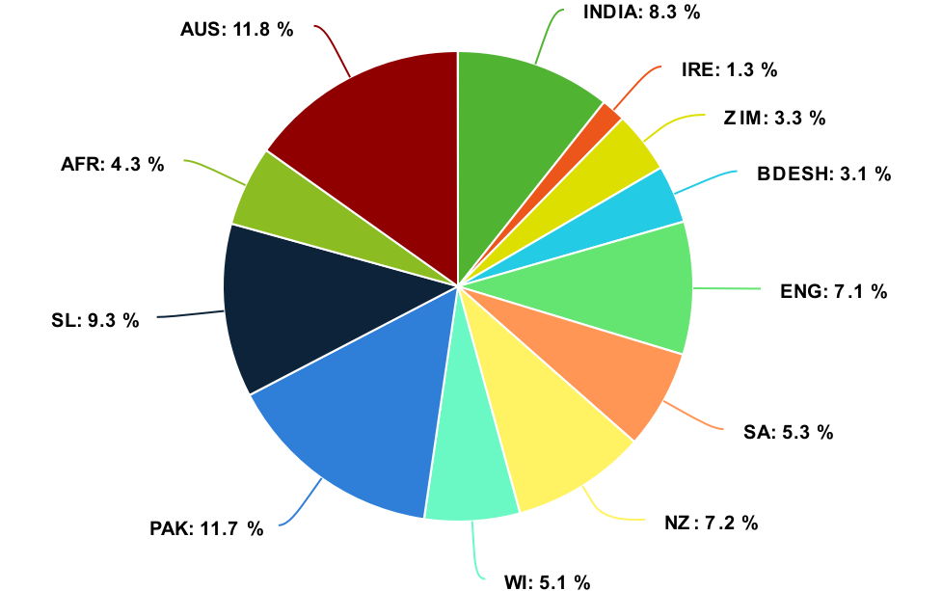
Visualization 3
The pie chart depicts the players percentage of having ducks outs (0s) in a region. Duck out means that they've been bowled out, or dismissed, before getting any runs.

Slide 10

Task
Description:
Target Attribute: 100 (no. Of 100 scored by a player)
Output: Predicted regression
Task Type: Classification and Regression

Slide 11

Task
2. Preprocessing:
After properly importing the dataset, preprocessing was done
Involves cleaning inconsistent and irrelevant data
Managed blank and null values
Some of the values are modified and replaced with appropriate one
After the preprocessing, model training was done.

Slide 12
Task
3. Modelling:
In this stage, we divided the dataset into two parts
One part goes for Training and other for Testing.
75% of the data is used for training and 25% for testing.
After training, we tested the model for accuracy.

Slide 13

Logistic Regression
Logistic regression is commonly used for prediction and classification problems
Logistic regression is a statistical analysis method to predict the regressive outcome of a target variable.
A logistic regression model predicts a dependent data variable by analyzing the relationship between one or more existing independent variables.

Slide 14
SVM
Support Vector Machine is a linear model for classification and regression problems. It can solve linear and non-linear problems and work well for many practical problems.
SVC works by mapping data points to a high-dimensional space and then finding the optimal hyperplane that divides the data into two classes.
The goal of SVM is to produce a model (based on the training data) which predicts the target values of the test data given only the test data attributes.
Notes:
The idea of SVM is simple: The algorithm creates a line or a hyperplane which separates the data into classes.

Slide 15
Models vs Accuracy
Model | Accuracy | F1 Score | Precision | Recall
Logistic Regression | 0.8816 | 0.8702 | 0.8604 | 0.8816
SVM | 0.8752 | 0.8468 | 0.8226 | 0.8752
Notes:
We also tried different models, but didn’t get a good score
Precision - classify positive samples in the model.
Recall measure how many positive samples were correctly classified by the ML model.
The F1-score combines the precision and recall into a single metric by taking their mean

Slide 16
Applications
These results can be used by Cricket analyst to auction player for a league.
Team coach can view these analysis and prepares a strategy for a match.
Results can be used by captain for making the right decision on and off the field.

Slide 17


